Slide 1
Fair Housing Forum: Understanding and Enforcing Fair Housing
North Penn Legal Service: Overview of Fair Housing
Lori Molloy, Esq. & Marybeth Saporita

Slide 2
FAIR HOUSING Overview
Laws that protect certain individuals (protected classes) from discrimination in housing transactions
Laws apply to “dwellings" (structures designed or occupied as residences or land offered for sale where a residence will be built)

Slide 3
Protected Classes
RACE
COLOR
NATIONAL ORIGIN
RELIGION
SEX (1974)
FAMILIAL STATUS (1988)
DISABILITY (1988)
AGE
(under PHRA, 40 years and older)

Slide 4
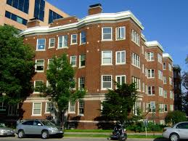
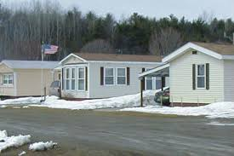
Defining a Dwelling
Private housing
Public housing and subsidized housing
Manufactured home communities
Group homes
Rooming or boarding houses
Nursing homes and assisted living centers
Residential drug & alcohol treatment facilities
Homeless shelters
(case-by-case basis)
University housing (dorms)
Vacant land offered for sale or lease

Slide 5
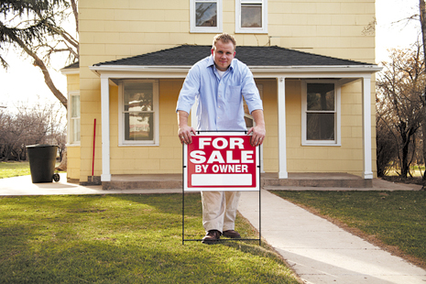
Dwelling Exemptions
FHA: exempts owner-occupied buildings with no more than four units, single-family housing sold or rented without the use of a broker, and housing operated by organizations and private clubs that limit occupancy to members or organizations and private clubs.
Pennsylvania Human Relations Commission: two unit building where one of the units is occupied by the owner

Slide 6
Coverage
Fair Housing Act (federal)
Title VIII of the Civil Rights Act of 1968
42 U.S.C. 3601, Section 800
Sets the minimum protections
HUD’s Equal Access Rule (federal)
recipients of federal funding
Section 504 of the Rehabilitation Act (federal)
recipients of federal funding
Pennsylvania Human Relations Act (state)
Cities, municipalities, etc. can also have laws
Allentown, Bethlehem, Easton

Slide 7
Fair Housing Act
Prohibits specific actions based on an individual being a member of a protected class, including:
Refuse to rent or sell housing or otherwise make housing unavailable
Including imposing different terms for loans
Set different terms, conditions or privileges for sale or rental of a dwelling
Provide different housing services or facilities
Falsely deny that housing is available for inspection, sale, or rental
Advertise or make any statement that indicates a limitation or preference based on being a member of a protected class
Take action against someone exercising a fair housing right
Additional protections if you have a disability

Slide 8
Laws & Regulations Specific to Federally Funded Housing
Hud’s equal access rule
Section 504 of the rehabilitation act
(DHHS §504 45 CFR Part 84)
Requires equal access to HUD programs without regard to actual or perceived sexual orientation or gender identity or marital status in:
HUD assisted housing (public housing, Section 8 Housing Choice Vouchers, project-based Section 8)
Housing whose financing is insured by HUD
FHA-insured mortgage financing
Prohibits discrimination on the basis of disability in programs & activities conducted by HUD or receipt ants of financial assistance from HUD
Enforces the right of individuals to live in federally subsidized housing free from discrimination on the basis of disability.
Covers all HUD programs except for its mortgage insurance and loan guarantee programs.
Forbids organizations from excluding or denying individuals with disabilities equal opportunity to receive program benefits and services

Slide 9
State and Local Protections
Pennsylvania Human Relations Act
Allentown, Bethlehem & Easton
Makes it illegal to discriminate in a housing related transaction on the basis of age, above the age of 40.
Cannot discriminate on the basis of sexual orientation, gender identity and gender expression
Cannot discriminate on the basis of marital status

Slide 10
Additional Rights for Individuals with Disabilities for Equal Enjoyment
Reasonable Modifications
Reasonable Accommodations
Structural change to
Interior
Exterior
Common areas
Under Section 504, costs paid by housing provider if receives federal funding
Change, exception, or adjustment to a rule, practice, or service
Can be requested at any time prior to actually being evicted
Landeck v. Lebannon County Housing Authority, 967 A.2D 1009 (Pa. Super 2009)

Slide 11
Accommodations May Not Be Required If:
Undue Financial And Administrative Burden On Housing Provider
Tenant poses a direct threat to the health or safety of other residents or housing provider’s staff
Tenant would cause substantial physical damage to another person’s property
Burden of Proof:
Housing provider has the burden to show tenant is a direct threat or will cause substantial physical damage
High burden

Slide 12
Enforcing the Fair Housing Act
Tenant Raising a Defense in Eviction Action
Complaint Filed with:
Dept. of Housing & Urban Development (HUD): 1 year
PA Human Relations Commission (PHRC): 180 days
City Human Relations Commission:
Allentown & Bethlehem: 180 days
Easton: 300 days
Lawsuit Filed in State or Federal Court: 2 years

Slide 13
Violation of Fair Housing Laws: Consequences
Money Damages to Victims
Fines
Injunctive Relief
Mandatory Fair Housing Training for Housing Provider, Landlord, Management Company or Realty Company
Attorney’s Fees
Types of Reliefs Ordered by Courts

Slide 14
North Penn Legal Services www.northpennlegal.org
Information on self-help legal topics, latest news & events updated regularly
559 Main Street, Suite 200, Bethlehem, PA 18018
Phone: (610) 317-8757
Office hours: Monday - Friday 9:00 – 12:00 / 1:00 - 5:00
Intake Line: 1-877-953-4250 or apply on our website 24/7
Monday, Tuesday, Wednesday, Thursday
9:00 – 11:30 A.M. / 1:30 – 4 :00 P.M.
Friday 9:00 – 11:30 A.M.

